Slide 1
Object-Oriented Programming and Data Abstraction Lesson 9: File IO
Notes:
Replace this with your course title and your name/contact details.

Slide 2
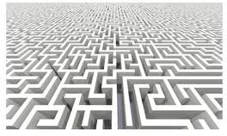
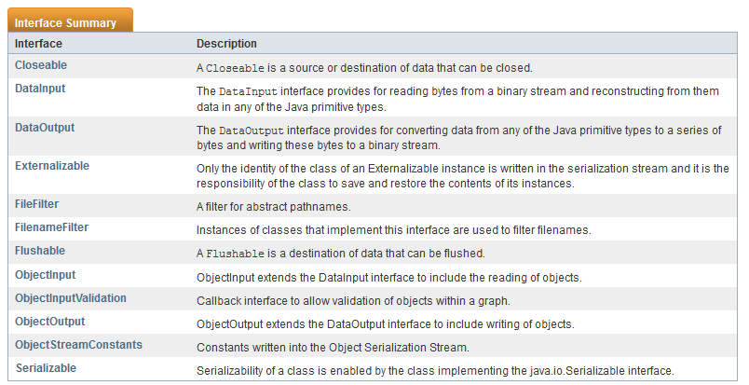



Java IO Library
complex
java.io package covers most input and output
Closeables are what you can create in a try with resources
Interfaces

Slide 3
Byte-based vs. Character-based Processing
Sometimes you want to read or write raw bytes from or to a file directly
Sometimes you want to interpret those bytes as text.
Example:
5
0
0
0
0
0
1
0
1
0
0
1
1
0
1
0
1
5 as a byte
5 as a character (decimal 53)
Dec | Hex | Oct | HTML | Chr
53 | 35 | 065 | &#53 | 5

Slide 4
Which Class to Use?
Purpose ▼ | Byte Based |  | Character Based
 | Input | Output | Input | Output
Generic forms (super classes) | InputStream | OutputStream | Reader (abstract) InputStreamReader | Writer (abstract) OutputStreamWriter
Arrays | ByteArray InputStream | ByteArray OutputStream | CharArrayReader | CharArray Writer
Files | FileInputStream RandomAccessFile | FileOutputStream RandomAccessFile | FileReader | FileWriter
Pipes | PipedInputStream | PipedOutputStream | PipedReader | PipedWriter
Buffering | BufferedInputStream | BufferedOutputStream | BufferedReader | BufferedWriter
Filtering | FilterInputStream | FilterOutputStream | FilterReader | FilterWriter
Parsing | PushbackInputStream StreamTokenizer |  | PushbackReader LineNumberReader
Strings |  |  | StringReader | StringWriter
Data | DataInputStream | DataOutputStream
Data - Formatted |  | PrintStream |  | PrintWriter
Objects | ObjectInputStream | ObjectOutputStream
Utilities | SequenceInputStream
http://tutorials.jenkov.com/java-io

Slide 5
IO Exceptions
Input-output is particularly error-prone
It involves interaction with the external environment
Checked exception for Java I/O
java.io.IOException – a generic I/O exception
EOFException – more specific end of file exception
FileNotFoundException – more specific file not found exception

Slide 6
IO Exception Hierarchy
Exception
IOException
CharCoversionException
ObjectStreamException
EOFException
InvalidClassException
FileNotFoundException
InvalidObjectException
NotActiveException
InterruptedIOException
NotSerializableException
SyncFailedException
OptionalDataException
UnsupportedEncodingException
StreamCorruptedException
UTFDataFormatException
WriteAbortedException

Slide 7
Understanding IO

Slide 8



Input and Output
An InputStream or Reader is linked to a source of data.
Program
An OutputStream or Writer is linked to a destination of data.
InputStream / Reader
OutputStream / Writer
Source
Destination
System.in
I am an input file that contains data that needs to be read by a program
System.err
System.out
input file
I am an output file that has data which was produced by a program.
memory buffer
memory buffer
output file
NW connection
NW connection
pipe
pipe

Slide 9
The Point of the IO Library
File Access
Network Access
Internal Memory Buffer Access
Inter-Thread Communication (Pipes)
Buffering
Filtering (e.g., LineNumberInputStream adds line numbers in the destination file that do not exist in the source file)
Parsing (e.g., HTML, XML)
Reading and Writing Text (Readers / Writers)
Reading and Writing Primitive Data (long, int etc.)
Reading and Writing Objects
http://tutorials.jenkov.com/java-io

Slide 10
Working with Files

Slide 11
Working with Files: Which classes to use?
byte-based
Reading Files via Java IO
If you need to read a file from one end to the other → FileInputStream.
If you need to jump around the file and read only parts of it from here and there → RandomAccessFile.
Writing File via Java IO
If you need to write a file from one end to the other → FileOutputStream.
If you need to skip around a file and write to it in various places, for instance appending to the end of the file → RandomAccessFile.
http://tutorials.jenkov.com/java-io

Slide 12
Working with Files: Random Access
byte-based
Random Access to Files via Java IO
You can get random access to files via Java IO.
Random doesn't mean that you read or write from truly random places.
It just means that you can skip around the file and read from or write to it at the same time.
This makes it possible to write only parts of an existing file, to append to it, or delete from it.
http://tutorials.jenkov.com/java-io

Slide 13
InputStream
The read() method returns a int containing the byte value of the byte read.
If there are no more data to be read, the read() method returns -1
public class FileStreamDemo {
public static void main(String[] args) {
int data = 0; // Notice that this example is byte-based.
try (InputStream input = new FileInputStream("resources/ada.txt")) {
do {
data = input.read();
System.out.print(data + " "); // echo the data read to console
} while (data != -1);
System.out.println();
input.close(); // really not needed, because try with resources will close
}
catch (IOException e) { e.printStackTrace(); }
data = 0; // reset variable to store bytes
// Re-read data, but printout character equivalents
try (InputStream input = new FileInputStream("resources/ada.txt")) {
while (data != -1) {
data = input.read();
if (data != -1) System.out.print((char) data + " "); // echo the data
}
}
byte-based
Polymorphic use of InputStream.
why?
Output

Slide 14
Working with Files: Which classes to use?
character-based
The FileReader class lets you read the contents of a file as a stream of characters.
It works much like the FileInputStream except the FileInputStream reads bytes, whereas the FileReader reads characters.
One character may correspond to one or more bytes depending on the character encoding scheme. (e.g., UTF-8 vs UTF-16)
The read() method of a FileReader returns an int which contains the char value of the character read.
If the read() method returns -1, there is no more data to read in the FileReader, and it can be closed. That is, -1 as int value, not -1 as character value. There is a difference here!
http://tutorials.jenkov.com/java-io

Slide 15
Working with Files: Which classes to use?
character-based
/* Case 1: Use FileReader */
try (Reader myReader = new FileReader(FILE_NAME)) {
System.out.println("\nIs the stream ready? " + myReader.ready());
printline();
while ((i = myReader.read()) != -1) {
myReader.skip(1); // Let's skip every other character
System.out.print((char) i);
}
System.out.println(System.lineSeparator());
}
catch (IOException e) {
e.printStackTrace();
}
FileReader has methods to read() a character, skip() a character or close() the stream. Close is invoked by try with resources
http://tutorials.jenkov.com/java-io

Slide 16
Working with Files: Which classes to use?
character-based
The FileWriter class lets you write the contents of a file as a stream of characters.
When you create a FileWriter you can decide whether to overwrite or append to the specified file.
The constructor taking just one parameter, the file name, will overwrite any existing file or create a new one:
Writer writer = new FileWriter("c:\\data\\output.txt");
Another constructor takes 2 parameters -- the file name and a boolean.
Writer writer = new FileWriter("c:\\data\\output.txt", true); //append Writer writer = new FileWriter("c:\\data\\output.txt", false); //overwrite
http://tutorials.jenkov.com/java-io

Slide 17
Using Writers
private static final String FILE_NAME_1 = "resources/output_o.txt";
private static final String FILE_NAME_2 = "resources/output_a.txt";
private static final boolean APPEND_MODE = true;
private static final boolean OVERWRITE_MODE = false;
try (Writer myWriter_O = new FileWriter(FILE_NAME_1, OVERWRITE_MODE);
Writer myWriter_A = new FileWriter(FILE_NAME_2, OVERWRITE_MODE);) {;
// In the beginning both files were opened as overwrite
myWriter_O.write("Working with FileReaders and FileWriters is rough!");
myWriter_A.write("Working with FileReaders and FileWriters is rough!");
myWriter_O.write(System.lineSeparator()); // new line (regardless of op system!)
myWriter_A.write(System.lineSeparator());
myWriter_O.write("Why did I sign up for this course?");
myWriter_A.write("Why did I sign up for this course?");
} catch (IOException e) { e.printStackTrace(); }
// Both comments were added to each file. (Overwrite is just how to BEGIN writing)
// Then each file was opened in a different mode
try (Writer myWriter_O = new FileWriter(FILE_NAME_1, OVERWRITE_MODE);
Writer myWriter_A = new FileWriter(FILE_NAME_2, APPEND_MODE);) {
myWriter_O.write(System.lineSeparator());
myWriter_A.write(System.lineSeparator());
myWriter_O.write("Scratch that. FileReaders and FileWriters are easy.");
myWriter_A.write("Scratch that. FileReaders and FileWriters are easy.");
myWriter_O.close();
myWriter_A.close();
// output_o only has one line in it; output_a has all three.
} catch (IOException e) { e.printStackTrace(); }

Slide 18
Working with Files: File Information / Directories
File and Directory Info Access
Sometimes you may need access to information about a file rather than its content.
e.g., file size or the file attributes.
The same may be true for a directory.
For instance, you may want to get a list of all files in a given directory.
Both file and directory information is available via the File class.
FileInfo demo
http://tutorials.jenkov.com/java-io

Slide 19
Using File for Directory and File Info
File myDirectory = new File("C:\\temp");
// Load an array list of file names
ArrayList<String> fileNames = new ArrayList<String>(Arrays.asList(myDirectory.list()));
// Load an array list of files
ArrayList<File> files = new ArrayList<File>(Arrays.asList(myDirectory.listFiles()));
try {
for (File f : files ) {
boolean executable = f.canExecute(); // based on permission (true even if
// if it's not an executable file!)
boolean writeable = f.canWrite();
boolean readable = f.canRead(); String absPath = f.getAbsolutePath(); // find the absolute path
System.out.print(absPath);
System.out.println(" is readable: " + readable +
"; is writeable: " + writeable +
"; is executable: " + executable);
Instant instant = Instant.ofEpochMilli(f.lastModified());
LocalDateTime date = instant.atZone(ZoneId.systemDefault()).toLocalDateTime();
System.out.println(" parent: " + f.getParent() + "; modified: " + date);

Slide 20
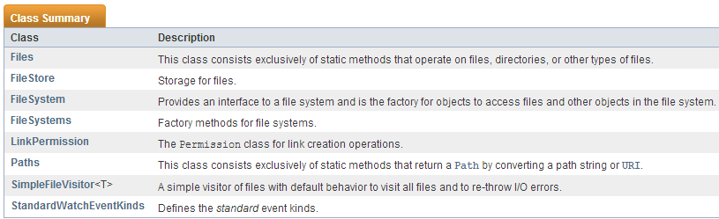
Static Methods from the Files Class
Don't confuse File class with Files class
http://docs.oracle.com/javase/7/docs/api/java/nio/file/package-summary.html
exists(Path)
notExists(Path)
isReadable(Path)
isWritable(Path)
isDirectory(Path)
isRegularFile(Path)
size(Path)
newDirectoryStream(Path)
createFile(Path)
createDirectory(Path)
createDirectories(Path)
delete(Path)

Slide 21
Examples (1)

Slide 22
Examples (2)

Slide 23
Examples (3)

Slide 24
Working with Pipes

Slide 25
Pipes (1)
Pipes in Java IO provides the ability for two threads running in the same JVM to communicate.
As such pipes are a common source or destination of data
public class Pipes {
public static void main(String[] args) throws Exception {
System.out.println("Test of Pipe IO\n");
Sender sender = new Sender(); // Sender & Receiver are classes in
// same file
Receiver receiver = new Receiver(sender);
sender.start(); // Start the sender thread
receiver.start(); // Start the receiver thread
Thread.sleep(8000); // Take an 8 second nap
sender.interrupt(); // Interrupt the sender thread
}
}

Slide 26
Pipes (2)
class Sender extends Thread {
private Random rand = new Random();
private PipedWriter out = new PipedWriter();
public PipedWriter getPipedWriter() {
return out;
}
// Invoking start() on a Thread will cause the JVM to invoke run() public void run() {
while (true) {
for (char c = 'A'; c <= 'z'; c++) {
// Just keep writing the characters from A to z
try {
out.write(c);
System.out.println("Wrote: " + c);
sleep(rand.nextInt(500));
} catch (InterruptedException e) {
System.out.println("* Sending thread has been interrupted and has stopped sending data");
return;
// return finishes the thread, but PipedWriter never closed!
} catch (IOException e) {
System.out.println(e.getMessage());
}
}
}
}
}
character-based

Slide 27
Pipes (3)
class Receiver extends Thread {
private PipedReader in;
public Receiver(Sender sender) throws IOException {
in = new PipedReader(sender.getPipedWriter());
}
// Invoking start() on a Thread will cause the JVM to invoke run() public void run() {
try {
while (true) {
// Blocks until characters are there:
System.out.println("\t\tRead: " + (char)in.read());
}
} catch (IOException e) {
/* We want to catch the fact that the sender did not close
* the PipedWriter after it was interrupted. This will
* trigger an IO exception for the PipedReader.
*/
System.out.println("\t\t* The sending thread finished without closing their side of the pipe.");
System.out.println("\t\t "+ e.getClass().getSimpleName() + " " + e.getMessage());
}
}
}
character-based

Slide 28
Working over a Network Connection

Slide 29
Java IO over a Network
byte-based
Once a network connection is established between two processes, the processes communicates via the network connection just like they would with a file:
an InputStream to read data
an OutputStream to write data.
In other words, Java IO is being used to pass the data to send to the Java networking API.
Basically this means that if you have code that is capable of writing something to a file, that same something could easily be written to a network connection.
All that is required is that your component doing the writing depends on an InputStream instead of a FileInputStream.
Since FileInputStream is a subclass of InputStream this should be no problem.
http://tutorials.jenkov.com/java-io

Slide 30
Working over standard Input and Output Streams

Slide 31
Java IO over the standard IO Streams
System.in
System.in is an InputStream which is typically connected to keyboard input of console programs.
We have used System.in when we create a Scanner object.
System.out
System.out is a PrintStream.
System.out normally outputs the data you write to it to the console.
We have used System.out.println() often.
System.err
System.err is a PrintStream.
System.err works like System.out except it is normally only used to output error texts.
Eclipse will show the output to System.err in red text, to make it more obvious that it is error text.
http://tutorials.jenkov.com/java-io

Slide 32

Example
public class SystemErrDemo {
public static void main(String[] args) {
try {
// Run a method that will cause an exception
raiseAnException();
}
catch (Exception e) {
System.err.println("Yes, we just caused an exception.
See below.\n");
// Using the printStackTrace of the Exception object
// also uses System.err
e.printStackTrace();
}
}
private static void raiseAnException() {
throw new IllegalStateException();
}
}

Slide 33
Switching Streams (1)
Exchanging System Streams
You can set a new InputStream for System.in
You can set a new OutputStream for System.out or System.err, and all further data will be read / written to the new stream.
To set a new System stream, use one of these methods:
System.setIn()
System.setOut()
System.setErr()
http://tutorials.jenkov.com/java-io

Slide 34


Switching Streams (2)
public class SwitchingStreams {
public static void main(String[] args) throws FileNotFoundException {
OutputStream output =
new FileOutputStream("c:\\temp\\redirectedOutput.txt");
PrintStream printOut = new PrintStream(output); // Need PrintStrean here
System.out.println("This should go to the console (System.out)");
System.setOut(printOut);
System.out.println("But this should go to a file.");
/* After you're done writing everything, some data may still be in * the buffer. Now you have to flush the buffer, to force it to * send all the data. */
printOut.flush();
// Of course you must close the file.
printOut.close();
}
}

Slide 35
Serialization

Slide 36
Object serialization (1)
Allows whole objects to be written into a file
Works both with simple and multi-component objects (i.e., collections)
Class must implement interface Serializable defined in package java.io
Interface Serializable has no methods
Serialization is handled automatically by runtime system

Slide 37
Object serialization (2)
The ability to store and retrieve Java objects is essential to building all but the most transient applications.
The key to storing and retrieving objects in a serialized form is representing the state of objects sufficient to reconstruct the object(s).
Objects to be saved in the stream implement the Serializable interface.
For Java objects, the serialized form must be able to identify and verify the Java class from which the contents of the object were saved and to restore the contents to a new instance.
For serializable objects, the stream includes sufficient information to restore the fields in the stream to a compatible version of the class.

Slide 38
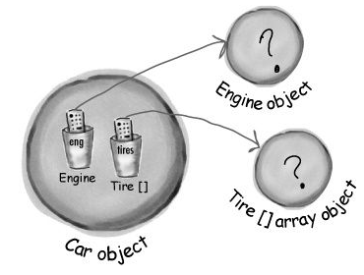
Object serialization (3)
When an object is serialized, all the objects it refers to from instance variables are also serialized.
Sierra, Kathy; Bates, Bert (2005-02-09). Head First Java

Slide 39
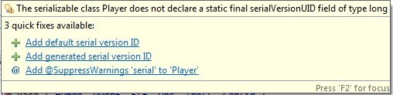
SerialVersionUID
The serialization runtime associates with each serializable class a version number, called a serialVersionUID
Used during deserialization to verify that the sender and receiver of a serialized object have loaded classes for that object that are compatible
If the receiver has loaded a class for the object that has a different serialVersionUID than that of the corresponding sender's class, then deserialization will result in an InvalidClassException.
A serializable class can declare its own serialVersionUID explicitly by declaring a field namedserialVersionUID that must be static, final, and of type long.
Eclipse can generate serial version IDs.

Slide 40
Object serialization: example (1)
implements Serializable interface
/** Player class
*
* @version 1.0
* @author J. Myers
*/
public class Player implements Serializable {
private static final long serialVersionUID = -8274170900300199913L;
private String name;
private Race race;
private Role role;
private char gender;
private int level;
private ArrayList<Statistic> stats;
private Zone zone;
public enum Role { WARRIOR, PRIEST, HUNTER, MAGE, PALADIN, WARLOCK, ROGUE }
Includes class constant serialVersionUID

Slide 41
Object serialization: example (2)
next version of Player
/** Player class
*
* @version 2.0
* @author J. Myers
*/
public class Player implements Serializable {
private static final long serialVersionUID = 7023486349133662975L;
private String name;
private Race race;
private Role role;
private char gender;
private int level;
private ArrayList<Statistic> stats;
private Zone zone;
public enum Role { WARRIOR, PRIEST, HUNTER, MAGE, PALADIN, WARLOCK, ROGUE, SHAMAN }
Version two gets a new serialVersionUID
new role in version 2

Slide 42
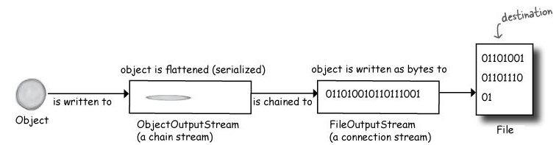
Connection Streams and Chain Streams
Connection streams represent a connection to a source or destination (file, socket, etc.)
Chain streams can’t connect on their own and must be chained to a connection stream.
The Java I/ O API has connection streams, that represent connections to destinations and sources such as files or network sockets, and chain streams that work only if chained to other streams.
Sierra, Kathy; Bates, Bert (2005-02-09). Head First Java

Slide 43
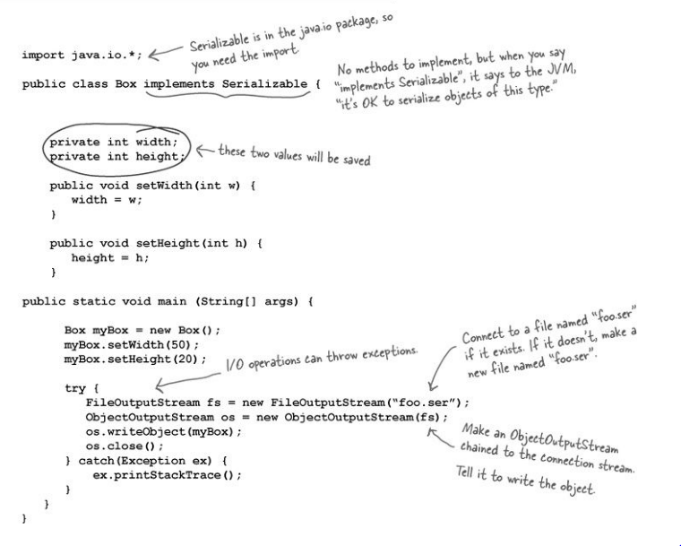
Sierra, Kathy; Bates, Bert (2005-02-09). Head First Java

Slide 44
For Homework
io.pipes package
Download the io.pipes package, run the code, and in a Word document explain how the IO is working in this application.
Serialize package
Download the serialize package, follow the instructions which can be displayed from the Driver class, and copy the console output from the deserialization into the Word document.

Slide 45
Working with Memory Buffers

Slide 46
But do we really want to read character by character?
In a FileReader, we read character by character
Reading every character, one at a time, is slow!
From the Java API:
A BufferedReader reads text from a character-input stream, buffering characters so as to provide for the efficient reading of characters, arrays, and lines. The buffer size may be specified, or the default size may be used. The default is large enough for most purposes.
In general, each read request made of a Reader causes a corresponding read request to be made of the underlying character or byte stream. It is therefore advisable to wrap a BufferedReader around any Reader whose read() operations may be costly, such as FileReaders and InputStreamReaders.

Slide 47
Buffering (1)
Buffered Streams
The examples in the previous section we've seen so far use unbuffered I/O.
This means each read or write request is handled directly by underlying OS.
This can make a program much less efficient, since each such request often triggers disk access, network activity, or some other operation that is relatively expensive.
To reduce this kind of overhead, the Java platform implements buffered I/O streams.
Buffered input streams read data from a memory area known as a buffer; the native input API is called only when the buffer is empty. Similarly, buffered output streams write data to a buffer, and the native output API is called only when the buffer is full.
The Java Tutorials, Oracle corporation

Slide 48
Buffering (2)
A program can convert an unbuffered stream into a buffered stream using a wrapping idiom, where the unbuffered stream object is passed to the constructor for a buffered stream class.
try (PrintWriter out = new PrintWriter( new BufferedWriter( new FileWriter(productsFile))))
There are four buffered stream classes used to wrap unbuffered streams:
BufferedInputStream and BufferedOutputStream create buffered byte streams
BufferedReader and BufferedWriter create buffered character streams.
Example of wrapping objects
The Java Tutorials, Oracle corporation

Slide 49
Flushing Buffered Streams
It often makes sense to write out a buffer at critical points, without waiting for it to fill. This is known as flushing the buffer.
Some buffered output classes support autoflush, specified by an optional constructor argument.
When autoflush is enabled, certain key events cause the buffer to be flushed.
For example, an autoflush PrintWriterobject flushes the buffer on every invocation of println or format.
To flush a stream manually, invoke its flush method. The flush method is valid on any output stream, but has no effect unless the stream is buffered.
The Java Tutorials, Oracle corporation

Slide 50
How does a BufferedReader work?
public class BufferedReader extends Reader { static final int DEFAULT_BUFFER_SIZE = 8192; char[] buffer; Reader in; // BufferedReader both extends a Reader and has-a Reader? public BufferedReader(Reader in) { this(in, DEFAULT_BUFFER_SIZE ); } public BufferedReader(Reader in, int size) { super(in.lock); if (size <= 0) throw new IllegalArgumentException("Illegal buffer size: " + size); this.in = in; buffer = new char[size]; public void close() throws IOException { synchronized (lock) { if (in != null) in.close(); in = null; buffer = null; } }
So it has the same
"interface" as Reader.
extends
has-a
Clients of BufferedReader ask it to close. Then BufferedReader turns around and asks its Reader to close!

Slide 51
The Decorator Pattern and File IO

Slide 52
The Decorator Pattern and Java IO classes

Slide 53
Decorator Pattern aka the "wrapper" pattern
Client
Please close
Reader
close()
read()
I'm done closing
So what's the big deal?
BufferedReader just passes to Reader
BufferedReader
close()
read()
Client
Please close
Reader
close()
read()
I'm done closing

Slide 54
It is a big deal (1) The decorator (wrapper) might have an improved mechanism
Client
Please read a character
Reader
close()
read()
'a'
All the client knows, is that it invoked the same method in both cases
BufferedReader
close()
read()
Client
Please read a character
Reader
close()
read()
if (in buffer)
else
'a'

Slide 55
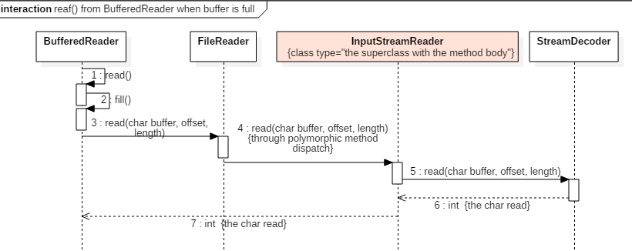
For completists only!
BufferedReader
close()
read()
Client
Please read a character
Reader
close()
read()
if (in buffer)
else
'a'
If BufferedReader's read() method has no more buffer, it will invoke its fill() method and then it will invoke its Reader's (which happens to be a FileReader) method read() with parameters for the buffer.
The superclass of FileReader

Slide 56
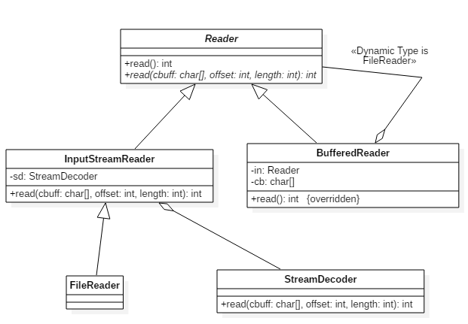
For completists only!
So, BufferedReader is-a Reader so that we can expect all Reader methods to exist (or be overridden)
BufferedReader has-a Reader (in this case a FileReader) to gain access to the useful read(cbuff, offset, length) method.

Slide 57
It is a big deal (2) The decorator (wrapper) might add new functionality
Client
Please read a character
Reader
close()
read()
'a'
All the client knows, is that it invoked the same method in both cases
BufferedReader
close()
readLine()
read()
Client
Please read a line
Reader
close()
read()
"augment your streams with buffers'"

Slide 58
Buffered Writers
Buffered writers work the same way as buffered readers.
A BufferedWriter will save up many of the little writes and send only large chunks of data to the FileWriter
Writing one large chunk to a file is more efficient than many small ones because each call to FileWriter.write() involves a call to the operating system, and those are slow.
In general, IO can be a bottleneck. Less frequent IO calls are generally better.

Slide 59
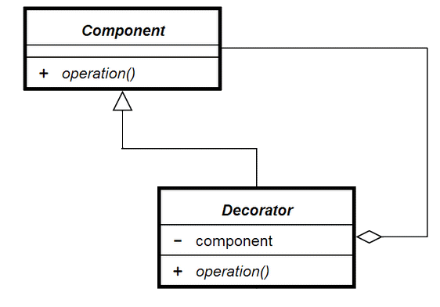
Decorator Pattern
The Decorator Pattern is used for adding additional functionality to a particular object as opposed to a class of objects.
It is easy to add functionality to an entire class of objects by subclassing, but it is impossible to extend a single object this way.
With the Decorator Pattern, you can add functionality to a single object and leave others like it unmodified.
Component is the superclass
Decorator is composed
of the superclass.
"Decorator wraps the superclass"
Clients interact with the Decorator using all the familiar operations of the Component…and maybe more!

Slide 60
Example of Decorator
Reader myReader = new FileReader(FILE_NAME);
while((i = myReader.read()) != -1) { System.out.print((char)i);
myReader.skip(1);
}
myReader.close();
// At runtime we can change what
// this one object is.
myReader = new BufferedReader(new FileReader(FILE_NAME));
Reader (abstract)
read, skip…
BufferedReader
read, skip…

Slide 61
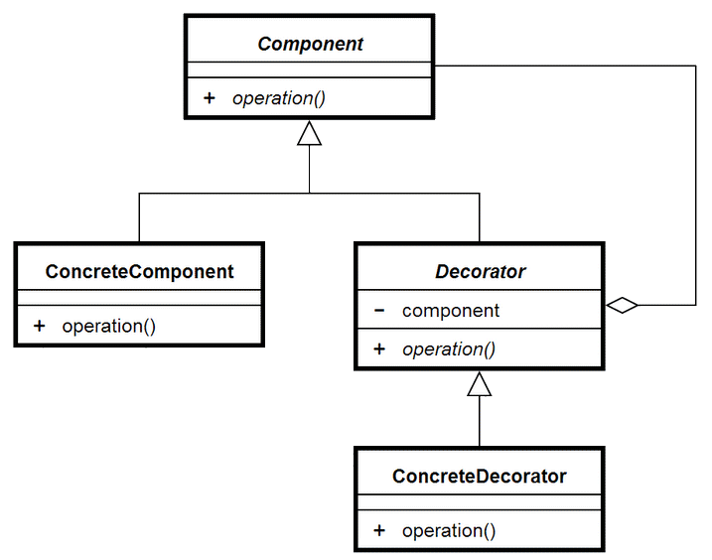
More advanced uses of Decorator
Decorator Pattern is more powerful when the Component and the Decorator are both abstract.

Slide 62
Another Example: PrintStream decorated FileOutputStream
PrintStream
FileOutputStream
See "switching streams" slide

Slide 63
One more example…
Try-with-resources
FileWriter decorated two times!

Slide 64
Readers, writers, streams
Readers and writers deal with textual input from a file
Based around the char type
Stream handlers deal with binary data files
Based around the byte type
The address-book-io project illustrates textual IO

Slide 65
Text input from file
try {
BufferedReader reader = new BufferedReader(new FileReader("filename"));
String line = reader.readLine();
while(line != null) {
do something with line
line = reader.readLine();
}
reader.close();
}
catch(FileNotFoundException e) {
the specified file could not be found
}
catch(IOException e) {
something went wrong with reading or closing
}

Slide 66
Other uses of Decorator

Slide 67

Decorator Pattern
The Decorator Pattern is used for adding additional functionality to a particular object as opposed to a class of objects.
It is easy to add functionality to an entire class of objects by subclassing, but it is impossible to extend a single object this way.
With the Decorator Pattern, you can add functionality to a single object and leave others like it unmodified.
Component is the superclass
Decorator is composed
of the superclass.
"Decorator wraps the superclass"
Clients interact with the Decorator using all the familiar operations of the Component…and maybe more!

Slide 68
Example of Decorator
Reader myReader = new FileReader(FILE_NAME);
while((i = myReader.read()) != -1) { System.out.print((char)i);
myReader.skip(1);
}
myReader.close();
// At runtime we can change what
// this one object is.
myReader = new BufferedReader(new FileReader(FILE_NAME));
Reader (abstract)
read, skip…
BufferedReader
read, skip…

Slide 69
More advanced uses of Decorator
Decorator Pattern is more powerful when the Component and the Decorator are both abstract.

Slide 70

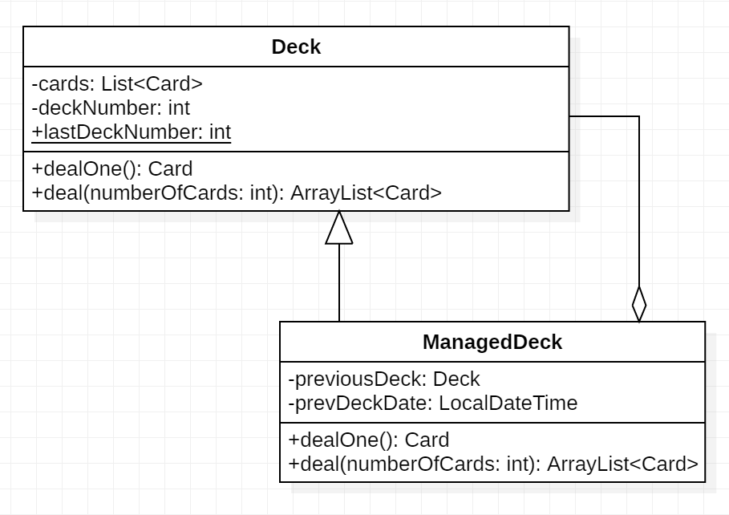
Decorator Example: Maintaining Deck State
Deck wrapped in Deck
ManagedDeck
Deck

Slide 71
Decorator Example: Encryption
Message letterToInstructor = new Email("Out sick", Calendar.getInstance().getTime(),
"I'm not feeling well and won't be in class today. Will make up work.",
"prof@college.edu", "me@hotmail.com");
// Use two decorators, EncryptorA and EncryptorB to decorate the message
EncryptorB encryptedLetterToInstructor = new EncryptorB(
new EncryptorA(letterToInstructor));
EncryptorA contains (wraps) the Message, which has an unencrypted message body.
EncryptorB contains (wraps) the EncryptorA, which has an encrypted message body.
The message body of EncryptorB is doubly encrypted.
To decrypt, you simply need to keep "unwrapping" the decorators.
Original message body: I'm not feeling well and won't be in class today. Will make up work.
Encrypted message body: I'm sil faaresg warr usd wis'l ba es crutt liduy. Werr muka op wink.
Once decrypted body: I'm nit faaleng wall und win't ba en cluss tiduy. Well muka op wirk.
Twice decrypted body: I'm not feeling well and won't be in class today. Will make up work.

Slide 72
Scanner

Slide 73
Text input from the terminal
System.in
An object of class java.io.InputStream associated with standard input
Maps to the terminal input
Often wrapped in a java.util.Scanner
Scanner supports parsing of textual input
nextInt, nextLine, etc.
Example:
Scanner sc = new Scanner(System.in);
int i = sc.nextInt();

Slide 74
Class Scanner with File
Scanner with File an alternative to BufferedReader with FileReader
Example:
Scanner sc = new Scanner(new File("myNumbers"));
while (sc.hasNextLong()){
long aLong = sc.nextLong();
}

Slide 75
Class Scanner with String
Scanner can also be used to parse String
Example:
String input = "1 fish 2 fish red fish blue fish";
Scanner s =
new Scanner(input).useDelimiter("\\s*fish\\s*");
System.out.println(s.nextInt());
System.out.println(s.nextInt());
System.out.println(s.next());
System.out.println(s.next());
s.close();
Output:
1
2
red
blue

Slide 76
SUPPLEMENTAL

Slide 77
Strings

Slide 78
The String Class

Slide 79
Ways to Create Strings

Slide 80
String Methods (1)

Slide 81
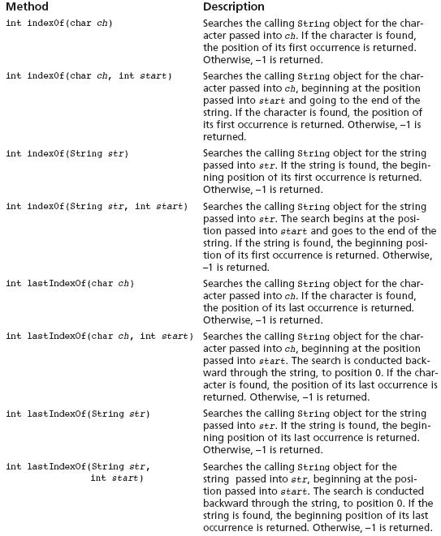
indexOf() and lastIndexOf()
These methods are useful for locating a character or a substring inside of a String object.

Slide 82
String Methods (2)

Slide 83
Substrings
The String class provides several methods that search for a string inside of a string.
A substring is a string that is part of another string.
Some of the substring searching methods provided by the String class:
boolean startsWith(String str)
boolean endsWith(String str)
boolean regionMatches(int start, String str, int start2, int n)
boolean regionMatches(boolean ignoreCase, int start, String str, int start2, int n)

Slide 84
Searching Strings
The startsWith method determines whether a string begins with a specified substring.
String str = "Four score and seven years ago";
if (str.startsWith("Four"))
System.out.println("The string starts with Four.");
else
System.out.println("The string does not start with Four.");
str.startsWith("Four") returns true because str does begin with “Four”.
startsWith is a case sensitive comparison.

Slide 85
Searching Strings
The endsWith method determines whether a string ends with a specified substring.
String str = "Four score and seven years ago";
if (str.endsWith("ago"))
System.out.println("The string ends with ago.");
else
System.out.println("The string does not end with ago.");
The endsWith method also performs a case sensitive comparison.
Example: http://jackmyers.info/java/src/Lesson-03/3-13/PersonSearch.java

Slide 86
Searching Strings
The String class provides methods that determine if specified regions of two strings match.
regionMatches(int start, String str, int start2, int n)
returns true if the specified regions match or false if they don’t
Case sensitive comparison
regionMatches(boolean ignoreCase, int start, String str, int start2, int n)
If ignoreCase is true, it performs case insensitive comparison

Slide 87
Searching Strings
The String class also provides methods that will locate the position of a substring.
indexOf
returns the first location of a substring or character in the calling String Object.
lastIndexOf
returns the last location of a substring or character in the calling String Object.

Slide 88
Searching Strings
String str = "Four score and seven years ago";
int first, last;
first = str.indexOf('r');
last = str.lastIndexOf('r');
System.out.println("The letter r first appears at "
+ "position " + first);
System.out.println("The letter r last appears at "
+ "position " + last);
String str = "and a one and a two and a three";
int position;
System.out.println("The word and appears at the "
+ "following locations.");
position = str.indexOf("and");
while (position != -1)
{
System.out.println(position);
position = str.indexOf("and", position + 1);
}

Slide 89
Extracting Substrings
The String class provides methods to extract substrings in a String object.
The substring method returns a substring beginning at a start location and an optional ending location.
String fullName = "Cynthia Susan Smith";
String lastName = fullName.substring(14);
System.out.println("The full name is " + fullName);
System.out.println("The last name is " + lastName);

Slide 90
Extracting Substrings
The fullName variable holds the address of a String object.
Address
“Cynthia Susan Smith”
The lastName variable holds the address of a String object.
Address
“Smith”

Slide 91
Extracting Characters to Arrays
The String class provides methods to extract substrings in a String object and store them in char arrays.
getChars
Stores a substring in a char array
toCharArray
Returns the String object’s contents in an array of char values.
This is useful when you want to iterate over every character in a string, for example in validation.
Example: http://jackmyers.info/java/src/Lesson-03/3-13/StringAnalyzer.java

Slide 92
Returning Modified Strings
The String class provides methods to return modified String objects.
concat
Returns a String object that is the concatenation of two String objects.
replace
Returns a String object with all occurrences of one character being replaced by another character.
trim
Returns a String object with all leading and trailing whitespace characters removed.

Slide 93
The valueOf Methods
The String class provides several overloaded valueOf methods.
They return a String object representation of
a primitive value or
a character array.
String.valueOf(true) will return "true".
String.valueOf(5.0) will return "5.0".
String.valueOf(‘C’) will return "C".

Slide 94
The valueOf Methods
boolean b = true;
char [] letters = { 'a', 'b', 'c', 'd', 'e' };
double d = 2.4981567;
int i = 7;
System.out.println(String.valueOf(b));
System.out.println(String.valueOf(letters));
System.out.println(String.valueOf(letters, 1, 3));
System.out.println(String.valueOf(d));
System.out.println(String.valueOf(i));
Produces the following output:
true
abcde
bcd
2.4981567
7

Slide 95
StringBuilder

Slide 96
StringBuilders
When you use the String class, the string has a fixed length and you can't edit the String. In other words, Strings in Java are immutable.
When you assign a new value to a String variable, the original String object is deleted, and it is replaced with a new String object that contains the new value.
This creation and deletion of String objects uses a lot of processing.
Imagine if you are building a String in a loop with many concatenations, e.g.
myString += "This is iteration " + i + ".";
Think of how many objects you are creating and destroying!
The StringBuilder class was designed to address this inefficiency.

Slide 97
The StringBuilder Class
The StringBuilder class is similar to the String class.
However, you may change the contents of StringBuilder objects.
You can change specific characters,
insert characters,
delete characters, and
perform other operations.
A StringBuilder object will grow or shrink in size, as needed, to accommodate the changes.

Slide 98
StringBuilder Constructors
StringBuilder()
This constructor gives the object enough storage space to hold 16 characters.
StringBuilder(int length)
This constructor gives the object enough storage space to hold length characters.
StringBuilder(String str)
This constructor initializes the object with the string in str.
The object will have at least enough storage space to hold the string in str.

Slide 99
Other StringBuilder Methods
The String and StringBuilder also have common methods:
char charAt(int position)
void getChars(int start, int end,
char[] array, int arrayStart)
int indexOf(String str)
int indexOf(String str, int start)
int lastIndexOf(String str)
int lastIndexOf(String str, int start)
int length()
String substring(int start)
String substring(int start, int end)

Slide 100
Appending to a StringBuilder Object
The StringBuilder class has several overloaded versions of a method named append.
They append a string representation of their argument to the calling object’s current contents.
The general form of the append method is:
object.append(item);
where object is an instance of the StringBuilder class and item is:
a primitive literal or variable.
a char array, or
a String literal or object.

Slide 101
Appending to a StringBuilder Object
After the append method is called, a string representation of item will be appended to object’s contents.
StringBuilder str = new StringBuilder();
str.append("We sold ");
str.append(12);
str.append(" doughnuts for $");
str.append(15.95);
System.out.println(str);
This code will produce the following output:
We sold 12 doughnuts for $15.95

Slide 102
Appending to a StringBuilder Object
The StringBuilder class also has several overloaded versions of a method named insert
These methods accept two arguments:
an int that specifies the position to begin insertion, and
the value to be inserted.
The value to be inserted may be
a primitive literal or variable.
a char array, or
a String literal or object.

Slide 103
Appending to a StringBuilder Object
The general form of a typical call to the insert method.
object.insert(start, item);
where object is an instance of the StringBuilder class, start is the insertion location, and item is:
a primitive literal or variable.
a char array, or
a String literal or object.
Example: http://jackmyers.info/java/src/Lesson-03/3-13/Telephone.java http://jackmyers.info/java/src/Lesson-03/3-13/TelephoneTester.java

Slide 104
Replacing a Substring in a StringBuilder Object
The StringBuilder class has a replace method that replaces a specified substring with a string.
The general form of a call to the method:
object.replace(start, end, str);
start is an int that specifies the starting position of a substring in the calling object, and
end is an int that specifies the ending position of the substring. (The starting position is included in the substring, but the ending position is not.)
The str parameter is a String object.
After the method executes, the substring will be replaced with str.

Slide 105
Replacing a Substring in a StringBuilder Object
The replace method in this code replaces the word “Chicago” with “New York”.
StringBuilder str = new StringBuilder(
"We moved from Chicago to Atlanta.");
str.replace(14, 21, "New York");
System.out.println(str);
The code will produce the following output:
We moved from New York to Atlanta.

Slide 106

Other StringBuilder Methods
The StringBuilder class also provides methods to set and delete characters in an object.
StringBuilder str = new StringBuilder("I ate 100 blueberries!");
// Display the StringBuilder object.
System.out.println(str);
// Delete the '0'.
str.deleteCharAt(8);
// Delete "blue".
str.delete(9, 13);
// Display the StringBuilder object.
System.out.println(str);
// Change the '1' to '5'
str.setCharAt(6, '5');
// Display the StringBuilder object.
System.out.println(str);
I ate 100 blueberries!
I ate 10 berries!
I ate 50 berries!

